Slide 1
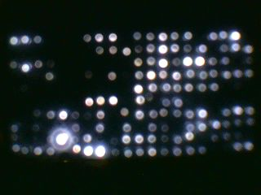
The black box
Computer
Video
camera
OUT
The black box consists of a cardboard box (23×23×50Cm) whose interior was isolated from the ambient light. The interior contained a duralumin skeleton which supported a digital camera targeted on the LED array.
The main strategy in this experiment consisted in making parallel measurements of the signals coming from the sensors.
LED array
Sensors
Supplementary material 1
IN

Slide 2
LED array organization
and signal encoding
IN
LED array
Sensors
The dorsal side (back)
The ventral side (front)
1.10 | 1.9 | 1.8 | 1.7 | 1.6 | 1.5 | 1.4 | 1.3 | 1.2 | 1.1
2.9 | 2.8 | 2.7 | 2.6 | 2.5 | 2.4 | 2.3 | 2.2 | 2.1 | 1.11
3.6 | 3.5 | 3.4 | 3.3 | 3.2 | 3.1 | 2.13 | 2.12 | 2.11 | 2.10
4.3 | 4.2 | 4.1 | 3.13 | 3.12 | 3.11 | 3.10 | 3.9 | 3.8 | 3.7
4.13 | 4.12 | 4.11 | 4.10 | 4.9 | 4.8 | 4.7 | 4.6 | 4.5 | 4.4
5.10 | 5.9 | 5.8 | 5.7 | 5.6 | 5.5 | 5.4 | 5.3 | 5.2 | 5.1
6.9 | 6.8 | 6.7 | 6.6 | 6.5 | 6.4 | 6.3 | 6.2 | 6.1 | 5.11
7.6 | 7.5 | 7.4 | 7.3 | 7.2 | 7.1 | 6.13 | 6.12 | 6.11 | 6.10
8.3 | 8.2 | 8.1 | 7.13 | 7.12 | 7.11 | 7.10 | 7.9 | 7.8 | 7.7
8.13 | 8.12 | 8.11 | 8.10 | 8.9 | 8.8 | 8.7 | 8.6 | 8.5 | 8.4
1.10 | 1.9 | 1.8 | 1.7 | 1.6 | 1.5 | 1.4 | 1.3 | 1.2 | 1.1
2.7 | 2.6 | 2.5 | 2.4 | 2.3 | 2.2 | 2.1 | 1.13 | 1.12 | 1.11
3.4 | 3.3 | 3.2 | 3.1 | 2.13 | 2.12 | 2.11 | 2.10 | 2.9 | 2.8
4.1 | 3.13 | 3.12 | 3.11 | 3.10 | 3.9 | 3.8 | 3.7 | 3.6 | 3.5
4.11 | 4.10 | 4.9 | 4.8 | 4.7 | 4.6 | 4.5 | 4.4 | 4.3 | 4.2
5.10 | 5.9 | 5.8 | 5.7 | 5.6 | 5.5 | 5.4 | 5.3 | 5.2 | 5.1
6.9 | 6.8 | 6.7 | 6.6 | 6.5 | 6.4 | 6.3 | 6.2 | 6.1 | 5.11
7.6 | 7.5 | 7.4 | 7.3 | 7.2 | 7.1 | 6.13 | 6.12 | 6.11 | 6.10
8.3 | 8.2 | 8.1 | 7.13 | 7.12 | 7.11 | 7.10 | 7.9 | 7.8 | 7.7
8.13 | 8.12 | 8.11 | 8.10 | 8.9 | 8.8 | 8.7 | 8.6 | 8.5 | 8.4
Supplementary material 1
encoded matrix

Slide 3
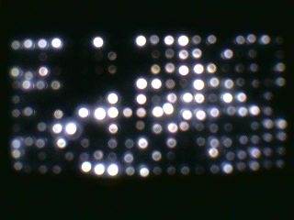
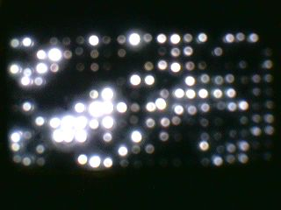
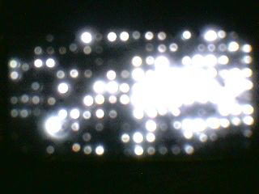
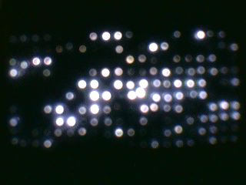
5s
Some examples of
black box images at
different discrete time
intervals
The signals from the sensors are translated into luminous intensities.
1200s
2300s
2600s
The video camera records 720 images/subject from the LED matrix over a period of 1h.
Here, four images are shown from a set of 720.
Supplementary material 1

Slide 4

Conversion of an image into
an ideal matrix by using
vector coordinates.
Supplementary material 1

Slide 5
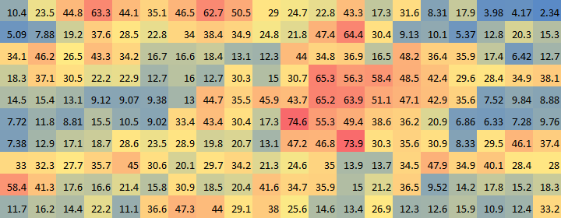

Average matrices
Average
encoded matrix
$$\sum{/n }$$
Supplementary material 1

Slide 6
Schematic diagram of
the neural network
The neural network has been trained using 36 images, each representing the average encoded matrix of an individual.
neural network
N 3
N 2
N 2
N 1
N 1
Average
encoded matrix
Supplementary material 1

